Slide 1
Amazon Sales Data Analysis

Slide 2
Introduction
Sales management has gained importance to meet increasing competition and the need for improved methods of distribution to reduce costs and increase profits. Sales management today is the most important function in a commercial and business enterprise.

Slide 3
Details of Data
1. Data Overview:
Source: Amazon sales data across various regions and countries.
Time Period: Data covers the years 2010 to 2017.
2. Key Metrics:
Revenue: Highest revenue from Honduras ($6.34M) and total revenue across all regions is $137.35M.
Profit: Sub-Saharan Africa leads with $12.18M in profits.
Units Sold: Total of 513K units sold, with significant sales in cosmetics and household items.
3. Data Segmentation:
Regions: Key regions include Sub-Saharan Africa, Europe, and Asia.
Items: Major categories include Cosmetics, Household, and Office Supplies.

Slide 4
Main KPIs
1. Revenue Growth:
Measure: Total revenue generated across different regions, countries, and item types.
Highlight: Maximum revenue recorded in 2012 ($31.8M).
2. Profit Margins:
Measure: Profit earned after deducting expenses, segmented by region and item type.
Highlight: Sub-Saharan Africa leads with $12.18M in profits.
3. Sales Volume:
Measure: Number of units sold across different regions, countries, and item types.
Highlight: 513K total units sold, with peak sales on Tuesdays.
4. Average Price per Item:
Measure: Average selling price across various item types.
Highlight: Household products have the highest average price among all item types.

Slide 5

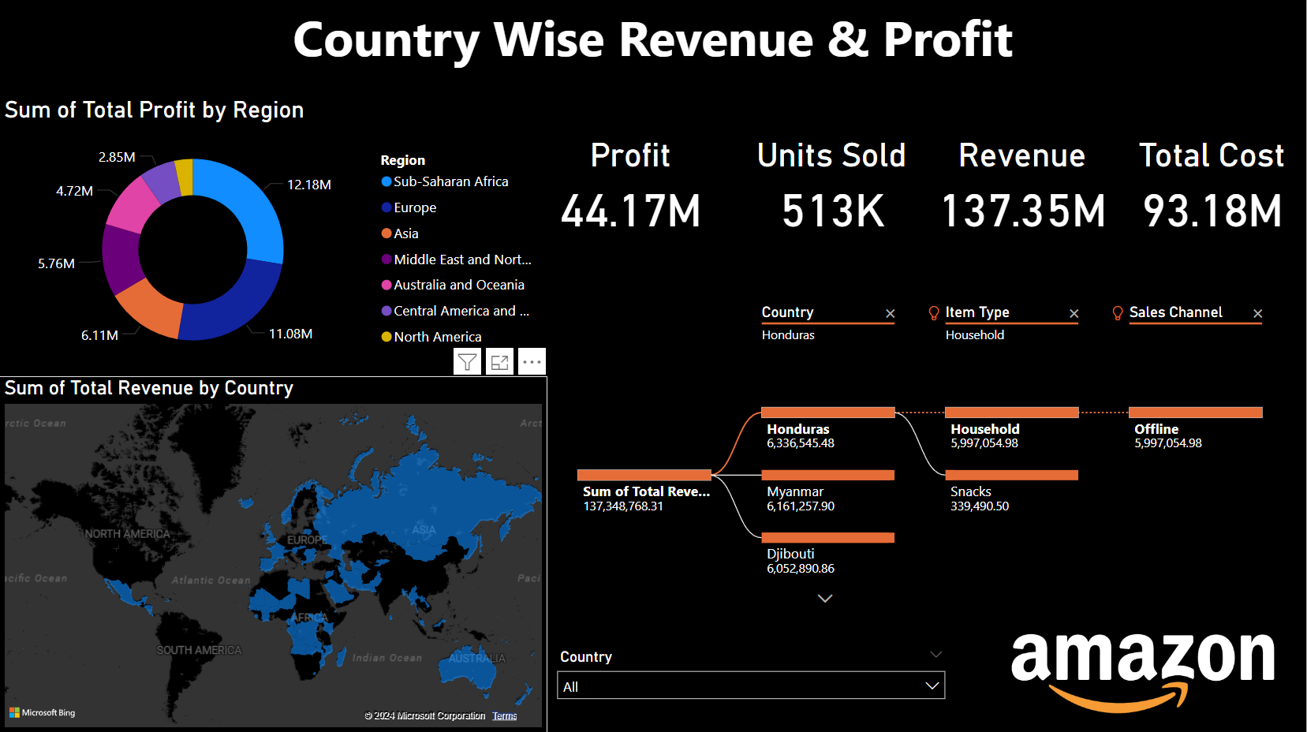
Dashboard

Slide 6
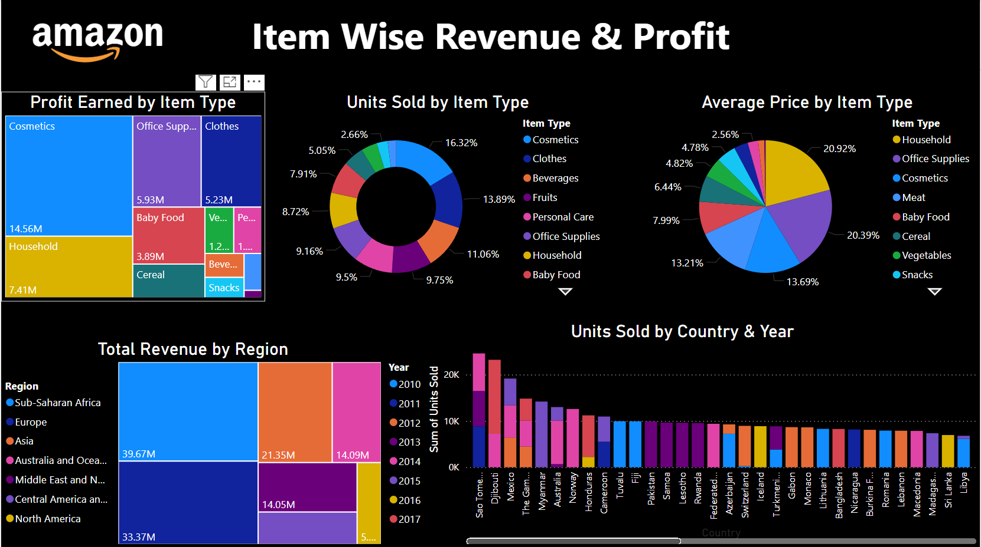
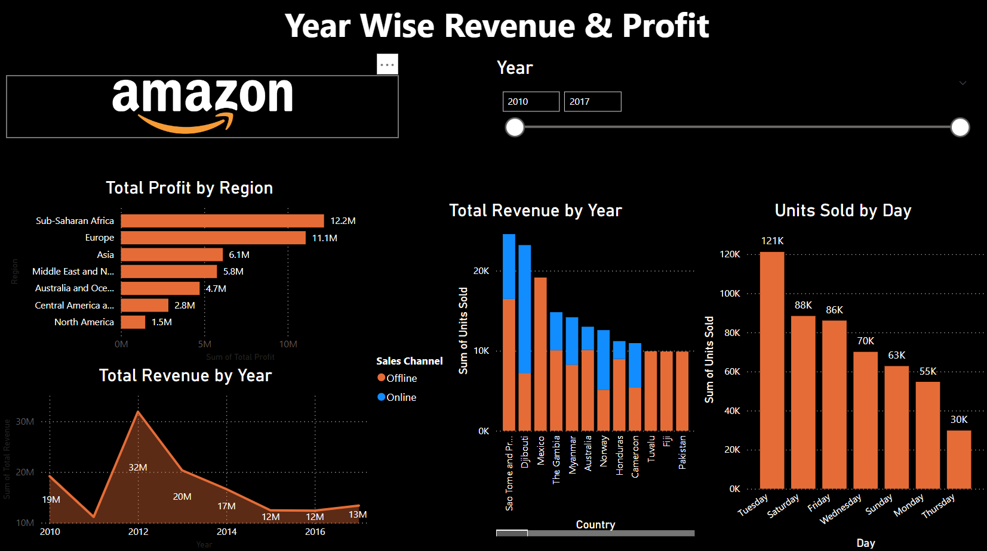
Dashboard

Slide 7
Thank you

